Slide 1
Stroke classification report
By: Ahmed Fathi

Slide 2
Problem
According to the World Health Organization, stroke is the second leading cause of death, accounting for 11% of total global deaths.
This report is looking at how likely a patient will get a stroke based on specific input parameters (gender, age, various diseases, and smoking status.)

Slide 3
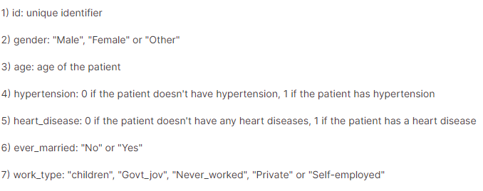
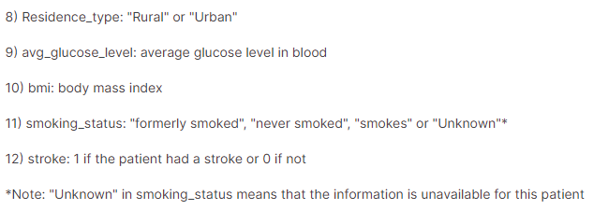
The data

Slide 4
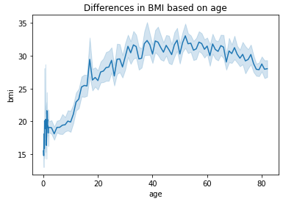
First visualization
This graph shows the relationship between all the patient’s ages in the data and their Body Mass Index (BMI)
When the age of the population gets to around 15-20, we see that BMI starts to increase, and continues to do so overtime with age.

Slide 5
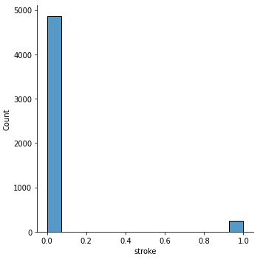
Second visualization
This is the count of people who have had strokes and who haven’t in our data pool.
The bar on the left are the patients who have not had a stroke incidence, classified with a 0 (total = 4861)
The bar on the right shows the count of those who have had a stroke, classified with a 1 (total = 249)

Slide 6
Models used
Started with a dummy classifier model as a baseline
Used a logistic regression model as I am looking to predict the incidence of stroke based on specific parameters
Used a KNN model to see if it would perform better. Even after hypertuning, it performed the same as the logistics regression model.

Slide 7
Strengths vs Limitations
Strengths of the analysis
The selected parameters are good indicators of diagnosing stroke incidence
Good mix of gender and age representation
Limitations of the analysis
Not enough representation of patients who had a stroke
Although this is more of a baseline way of predicting stroke incidence, there are many other factors that can attribute to stroke incidence (familial history, exercise routine, etc.)

Slide 8
Final recommendations
This data report is a good step in seeing the effect the observed parameters had on stroke incidence, however there needs to be a bigger pool of individuals who have experienced a stroke.

